Slide 1
DS3202: PARALLEL PROGRAMMING
MODULE – 1
Introduction to Parallel Programming
6th SEM
B.Tech
DSE

Slide 2
Introduction
Traditional Systems
Traditionally, computer software has been written for serial computation, called as sequential computing or traditional computing.
Sequential Computing is the type of computing where one instruction is given at a particular time and the next instruction has to wait for the first instruction to execute.
To solve a problem, an algorithm is constructed and implemented as a serial stream of instructions.
These instructions are executed on a Central Processing Unit on one computer.
It is having a single processor with low performance and high work-load for the processor.

Slide 3
Parallel Computing
Parallel computing perform computational tasks using multiple processors or cores simultaneously
This is accomplished by parallel processing, ie dividing the tasks into sub-tasks, which are then broken down further into instructions, and each instruction is then assigned to a different processor or cores
Parallel computing typically requires one computer with multiple processors and multiple cores.
Processors connect via a shared memory space
It saves time as the processes are executed simultaneously
It solves larger problems and complex calculations

Slide 4
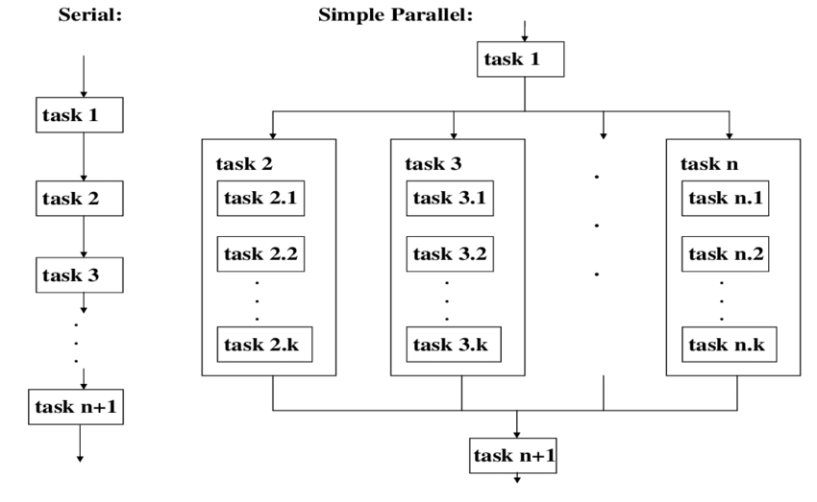
Diagram to show parallel programming

Slide 5
Example : Recolor an image
Developer writes a code to segment the image into equal parts.
Assign the recoloring of each part to a different parallel task, each running on their own compute resources.
Once the parallel tasks have completed, the full image is reassembled.

Slide 6
Traditional Computing Vs Parallel Computing
 | Traditional Computing | Parallel Computing
1 | All the instructions are executed in a sequence, one at a time. | All the instructions are executed parallelly.
2 | It has a single processor. | It is having multiple processors or cores
3 | It has low performance, and the workload of the processor is high due to the single processor. | It has high performance, and the workload of the processor is low because multiple processors or cores are working simultaneously.
4 | Bit-by-bit format is used for data transfer. | Data transfers are in bytes.
5 | It requires more time to complete the whole process. | It requires less time to complete the whole process.
6 | Cost is low | Cost is high

Slide 7
Terminologies in Parallel Programming
Sequential Processing
Parallel Programming
Task Decomposition
Synchronization
Efficiency and Speedup
Load Balancing
Shared Resources
Fault Tolerance

Slide 8
Processor Architectures
Processor architecture is the design of the CPU
This includes the instruction set design, microcode, ALU, instruction fetch and decode, internal caches, memory interface, I/O, power distribution and other more complex features
Traditional computer architecture - Von Neumann architecture (Princeton architecture)
Classification scheme for computer architectures that supports parallelism – Flynn’s taxonomy

Slide 9
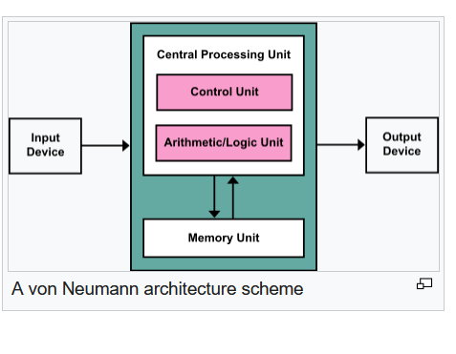
Von Neumann architecture

Slide 10
Von Neumann Architecture
Developed by John Von Neumann in 1945
Princeton University, New Jersy
Key components :
CPU : Execute instructions stored in memory. Performs arithmetic and logical operations, as well as control flow operations.
Control Unit : Manages the execution of instructions.
Arithmetic and Logic Unit (ALU) : Performs arithmetic and logical operations, such as addition, subtraction, AND, OR, etc.
Memory : Single memory space used for both program instructions and data.
I/O : Devices for input (e.g., keyboards, mice) and output (e.g., displays, printers) allow the computer to interact with the external world.

Slide 11
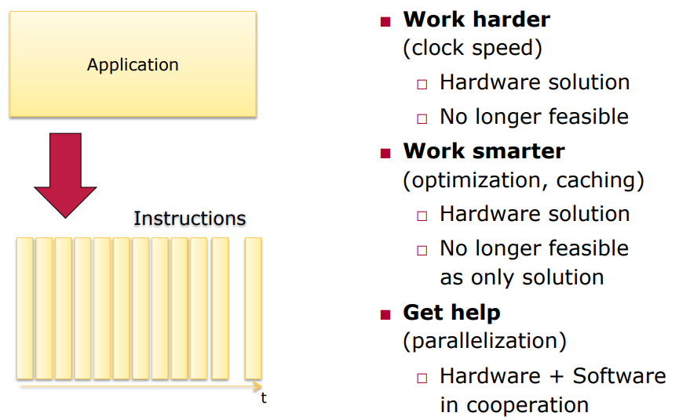
Three ways of doing anything faster

Slide 12
Work Harder
Number of transistors on chips doubling every two years according to Moore’s law. (more transistors, more clock cycles)
Industry was able to increase the frequency (F) for decades.

Slide 13
Bottleneck in Work Harder
Power Wall problem :
As the number of transistors on a chip increases, so does the power consumption.
Additionally, higher clock frequencies often lead to increased power consumption due to the dynamic power dissipated during each clock cycle.
If the power density (power per unit area) is too high, its challenging to dissipate the heat efficiently.

Slide 14
Work Smarter
Instruction Level Parallelism (ILP) : Capability of a computer to execute multiple instructions simultaneously or in parallel.
Techniques used to achieve ILP :
Pipelining : Divides the execution of instructions into several stages, and each stage is performed by a different segment of the processor. This allows for the parallel execution of multiple instructions at different stages of the pipeline.
Superscalar architecture : Instructions are dispatched to multiple execution units based on availability, allowing for parallel execution of multiple instructions in a single clock cycle.
Out of order execution : The processor dynamically reorders the execution of instructions to maximize the utilization of available execution units.
Vector processing : Perform the same operation on multiple data elements simultaneously.

Slide 15
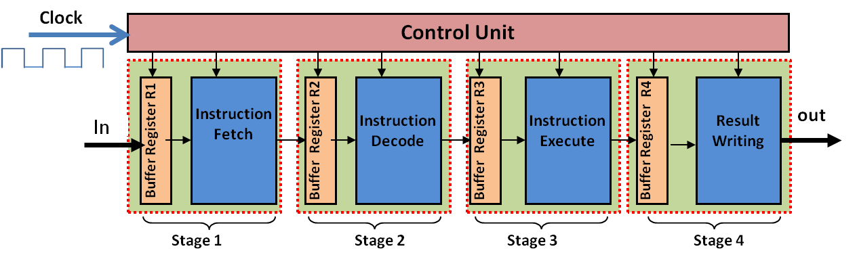
Pipelining

Slide 16
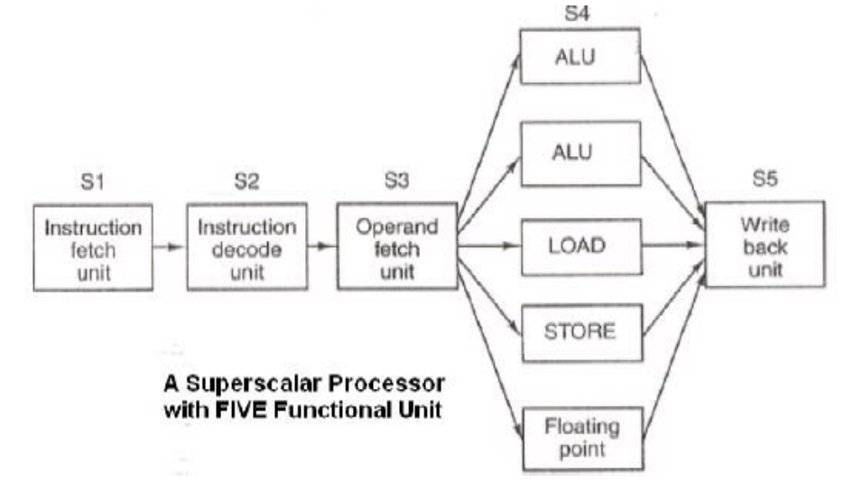
Superscalar architecture

Slide 17
Bottleneck in Work Smarter
ILP Wall : A point in the design of microprocessors where further attempts to exploit Instruction Level Parallelism (ILP) provide diminishing returns.
It becomes increasingly difficult to identify and execute more instructions in parallel.
Many instructions in a program depend on the results of previous instructions which creates constraints on the ability to execute instructions in parallel.
Deeper pipelines make the power problem worse.
A solution is to use caching.

Slide 18
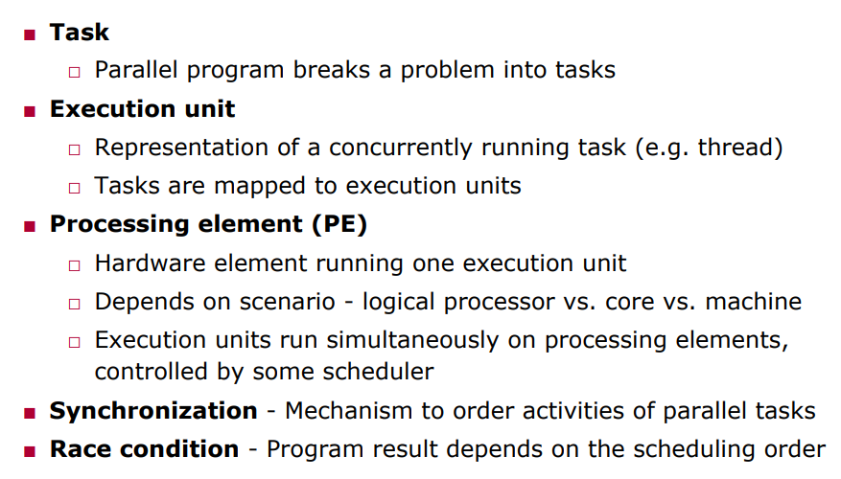
Parallelism

Slide 19
Flynn’s Taxonomy
Proposed by Michael J. Flynn in 1966
Framework for understanding and classifying parallel processing systems.
Categorizes computer architectures based on the number of instruction streams and data streams that can be processed concurrently.
The four categories are :
Single Instruction, Single Data (SISD)
Single Instruction, Multiple Data (SIMD)
Multiple Instruction, Single Data (MISD)
Multiple Instruction, Multiple Data (MIMD)

Slide 20
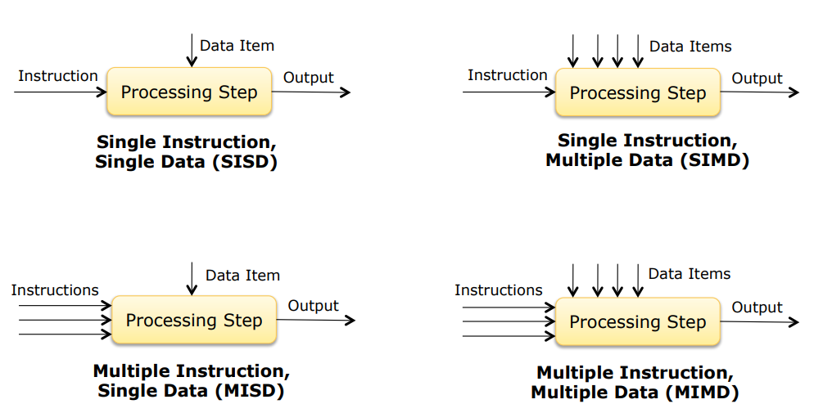
Categories of Flynn’s Taxonomy

Slide 21
Single Instruction, Single Data (SISD)
Only one instruction stream and one data stream.
This is the traditional von Neumann architecture, where a single processor executes a single instruction at a time on a single piece of data and is called scalar operations.
Example: Conventional sequential computer

Slide 22
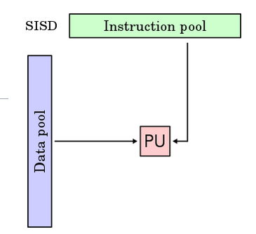

Slide 23
Single Instruction, Multiple Data (SIMD)
Multiple data streams processed with one instruction stream at the same time.
Example: Wireless MMX unit, Graphics processing units (GPUs) often use SIMD architecture to perform parallel processing on large sets of data, such as pixels in an image.

Slide 24
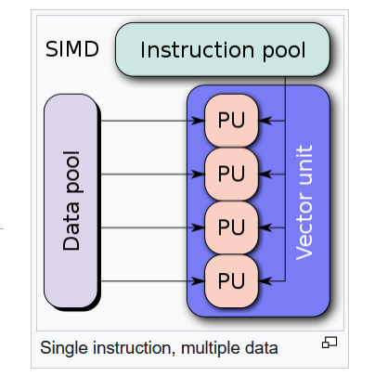

Slide 25
Multiple Instruction, Single Data (MISD)
Multiple instructions applied to the same data in parallel.
Rarely used in practice.
Hypothetical scenarios, such as having multiple processors applying different filters to the same image simultaneously.
Replication of Task
Eg: Space Shuttle flight control computers

Slide 26
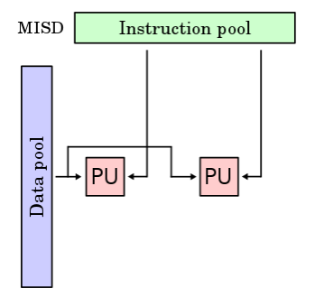

Slide 27
Multiple Instruction, Multiple Data (MIMD)
Multiple processors execute independent instruction streams on different sets of data.
Example: Most modern parallel computers, including multi-core processors, clusters, distributed computing system.

Slide 28
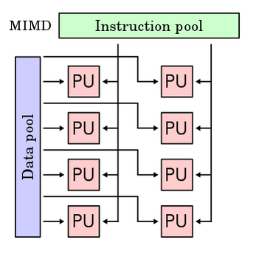

Slide 29
Performance Metrics and Enhancement
Uses of Parallelism
Speedup - Compute faster
Throughput - Compute more at the same time
Scalability - Compute faster/more with additional resources

Slide 30

Parallelization Metrics
Speedup :
is a number that measures the performance improvement achieved by parallelizing a computation compared to a sequential implementation.
The ratio of the time taken by the sequential algorithm to the time taken by the parallel algorithm.

Slide 31
Continues…….
Efficiency (E) :
Measures the utilization of resources in a parallel system.
Ratio of the speedup achieved to the number of processors used.
High efficiency indicates effective utilization of parallel resources.
Efficiency close to 1 implies effective utilization of parallel resources.

Slide 32
Continues……..
Scalability :
Measures how well a parallel algorithm or system can handle an increasing number of processors or workload size while maintaining or improving performance.
Good scalability means that the performance improves as the system size or workload increases.

Slide 33
LAWS OF PARALLEL PROGRAMMING
Amdahl's Law
Gustafson's Law
Amdahl's Law does not consider scalability factor as the workload cannot scale to much the available computing power as the machine size increases.
Gustafson's Law states that increase of problem size for large machines can retain scalability with respect to the number of processors. It is a counter argument to Amdahl’s law.

Slide 34
Amdahl’s Law
Developed by Dr. Gene Amdahl in 1967
A formula that expresses the potential speedup of a parallelized program.
It is a formula that estimates how much a system’s performance can improve when a part of it is improved.
Used to find the maximum expected improvement to an overall system when only part of the system is improved.
Predicts the theoretical maximum speedup using multiple processors.

Slide 35
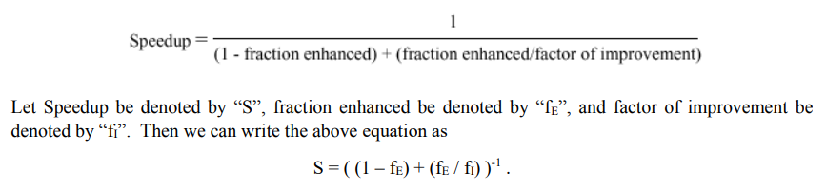
Formula for Amdahl’s Law

Slide 36
Key Features of Amdahl’s Law
Limit to Speedup : The speedup of a program is limited by the sequential portion of the code, not matter how many processors are added.
Diminishing Returns : As the number of processors (n) increases, the impact of the parallelizable portion (P) becomes less significant compared to the sequential portion (1−P).
Identifying Sequential Bottlenecks : Improving the parallelizable portion alone will not yield significant speedup if the sequential part remains a bottleneck..
Application to Parallel Programming : Serves as a tool for decision-making and resource allocation in parallel computing projects.

Slide 37
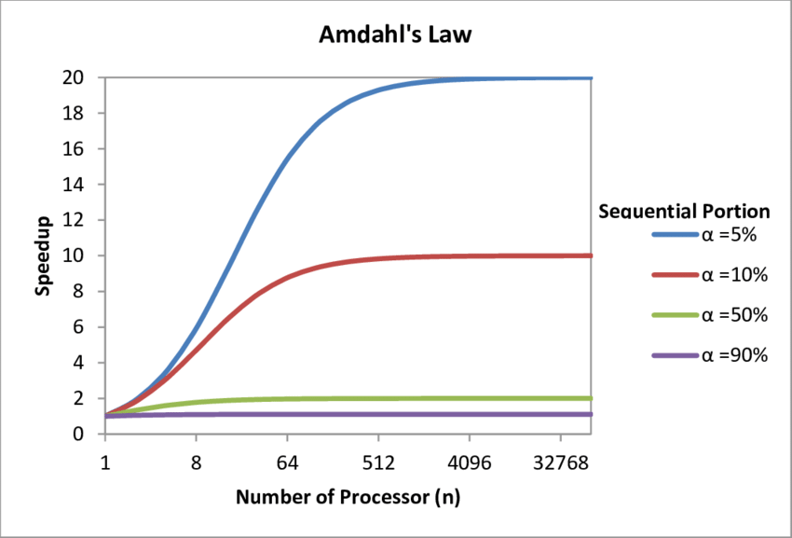
Graphical Representation

Slide 38
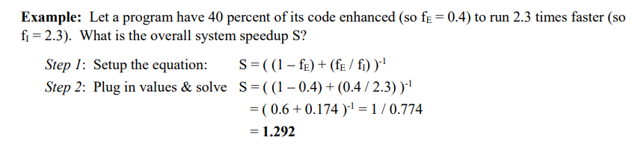
Problem 1-Amdahl's Law

Slide 39

Problem 2-Amdahl's Law
We are considering an enhancement to the processor of a web server. The new CPU is 20 times faster on search queries than the old processor. The old processor was busy with search queries 70% of the time, so we made 70% parallel, then what is the speedup gained by integrating the enhanced CPU?
Fraction_{enhanced}=0.70
Factor of improvement = 20

Slide 40
Gustafson's Law
Developed by John L Gustafson and Edwin H Barsis in 1988
They reevaluated Amdahl’s law
A scalability law that provides a different perspective on parallel computing compared to Amdahl's Law.
While Amdahl's Law focuses on the speedup achievable for a fixed problem size, Gustafson's Law emphasizes scaling performance with increasing data or workload.

Slide 41

Formula for Gustafson's Law
S_{p} is the speedup achieved by using p processors.
p is the number of processors.
f is a constant representing the portion of the computation that is inherently sequential.

Slide 42
Key Features of Gustafson's Law
Increasing Workload: The law assumes that as the number of processors increases, the size of the problem or workload also increases. In real-world applications, increasing computational resources are often associated with larger datasets or more extensive simulations.
Scaling with Data : Focuses on the ability to scale performance by handling larger problems rather than improving the execution speed of a fixed-size problem.

Slide 43
Difference between Amdahl’s and Gustafson’s Law
Amdahl’s Law emphasizes the impact of the non-parallelizable (sequential) portion of the computation on overall speedup. Gustafson’s Law assumes that as more resources become available (e.g., processors), larger problems can be efficiently solved.
Amdahl’s Law formula reflects the diminishing returns on speedup as more processors are added, constrained by the sequential portion of the program. Gustafson’s Law emphasizes that the speedup can approach the number of processors as the workload or problem size increases.
Amdahl's Law assumes a fixed-size problem or workload. Gustafson's Law assumes that the workload or problem size increases with the availability of more resources, such as processors.

Slide 44
Problem 3 : Amdahl’s and Gustafson’s Law
Assume that a program consists of 50% non-parallelizable code. Compute the speed-up when using 2 and 4 processors according to Amdahl’s and Gustafson's law.

Slide 45
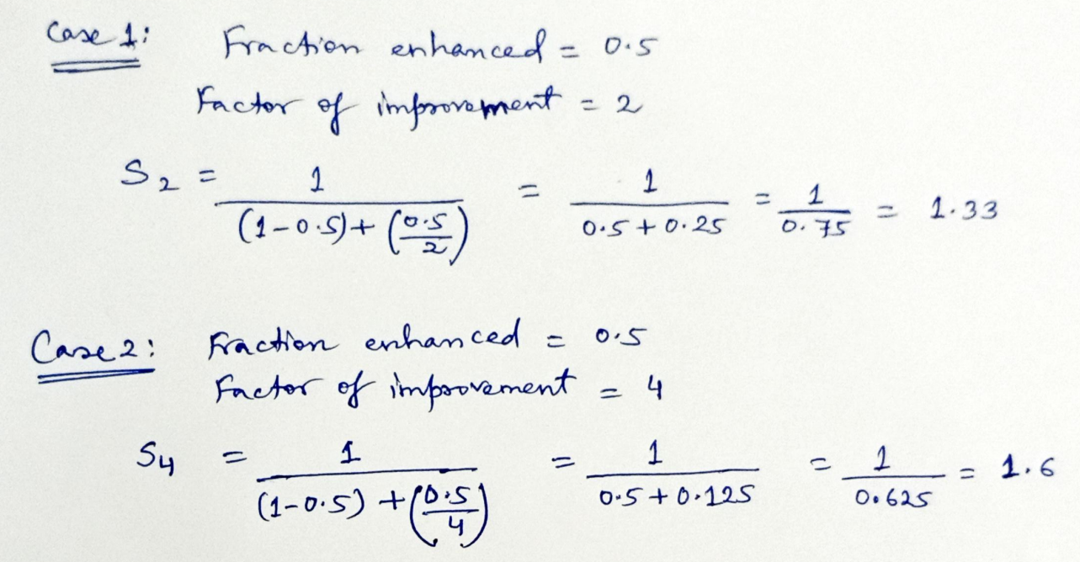
Solution as per Amdahl’s law

Slide 46
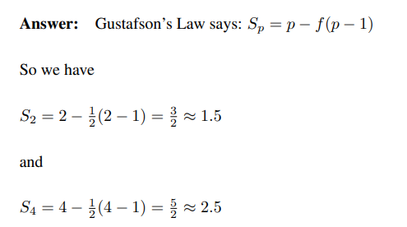
Solution as per Gustafson’s law

Slide 47
Explain why both speed-up results are different ?
Amdahl’s law sees the percentage of non-parallelizable code as a fixed limit for the speedup. So even if we had an infinite number of processors, according to Amdahl’s law, the speedup would never be greater than 2.
Gustafson’s law assumes that the parallel part of the program increases with the problem size and the sequential part stays fixed.

Slide 48
Parallel Programming
Parallel programming is the process of splitting a problem into smaller tasks that can be executed at the same time or in parallel using multiple computing resources
It is accomplished by assigning tasks to different cores or processors
Uniprocessor System
A uniprocessor system is defined as a computer system that has a single CPU that is used to execute computer tasks
Only one instruction will be executed at a time
All tasks and operations are handled by the single processor
The first computers were all uniprocessor systems.
Suitable for web browsing, word processing, and basic gaming
Examples:
Simple embedded systems, Car keys, digital alarm clocks, garage door openers, smoke detectors, etc

Slide 49
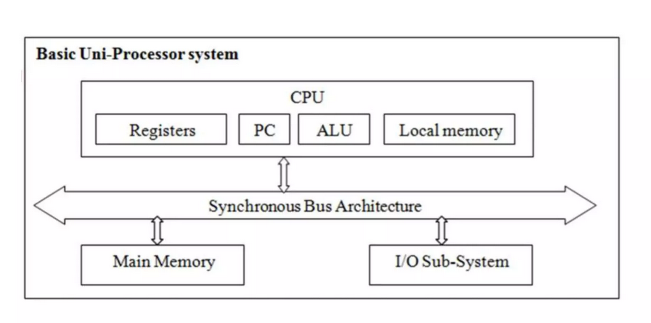

Slide 50
Parallelism or Multiprogramming in Uniprocessor System
Parallelism on a uniprocessor system can be achieved by using certain techniques such as pipelining and multitasking or time-sharing.
Pipelining
is a technique that allows a processor to execute a set of instructions simultaneously by dividing the instructions execution process into several stages. Each stage works on a different instruction at the same time, so that when one instruction is being fetched in the memory another instruction is being executed.
Multitasking or time-sharing
is a technique where it enables a uniprocessor to execute multiple tasks simultaneously. This is achieved by dividing the processor’s time into short time slots and switching tasks rapidly. Each task is given a specific time slot in which the needs to be executed. This gives the illusion of parallel execution even if the processor is only executing one task at a time

Slide 51
Advantages of Parallelism in Uniprocessor
Improves performance and throughput- Improves the performance of a uniprocessor by allowing it to execute multiple tasks or instructions simultaneously. This is achieved by increasing throughput which reduces the time required to complete a particular task.
Cost Effective- A Parallelism in uniprocessor is cost-effective for applications that do not require the performance of a multiprocessing system. The cost of a uniprocessor with parallelism is often lower compared to a multiprocessing system.
Low power consumption- A uniprocessor consumes less power than a multiprocessor system which makes it suitable for mobile and battery powers devices.

Slide 52
Disadvantage of Parallelism in Uniprocessor
Limited scalability– Parallelism is achieved in a very limited way and as the number of tasks or instructions being executed simultaneously increases, the performance decrease. This makes it unsuitable for applications that require high levels of parallelism.
Limited processing power– It has limited processing power as compared to a multiprocessing system hence it is not suitable for applications that require high computational power like scientific simulations and large-scale data processing.
Complex design– Implementing parallelism in a uniprocessor can be complex as it requires careful design and optimization to ensure that the system operates correctly and efficiently. This increases the development and maintenance costs of the system.

Slide 53
Applications of Parallelism in Uniprocessor
Multimedia applications– In multimedia applications such as video and audio playback, image processing, and 3D graphics rendering it helps in increasing performance.
Web servers– Provides assistance to web servers by allowing them to handle multiple requests simultaneously which makes it more reliable.
Artificial Intelligence and machine learning– It improves performance in artificial intelligence and machine learning applications allowing them to process large amounts of data more quickly.
Scientific simulations– Parallelism performs scientific simulations such as weather forecasting, fluid dynamics, and molecular modeling.
Database management systems– Parallelism in uniprocessors is used to improve the performance of database management systems by allowing them to handle large volumes of data more efficiently.

Slide 54
Multicore Systems
A processor with a single core is called a Unicore processor.
A processor with two or more cores is called a multicore processor.
The cores of a multicore processor can individually read and execute program instructions simultaneously.
This increases the speed of execution of the programs and supports parallel computing.
Eg: Quadcore processors, Octacore processors, etc.

Slide 55
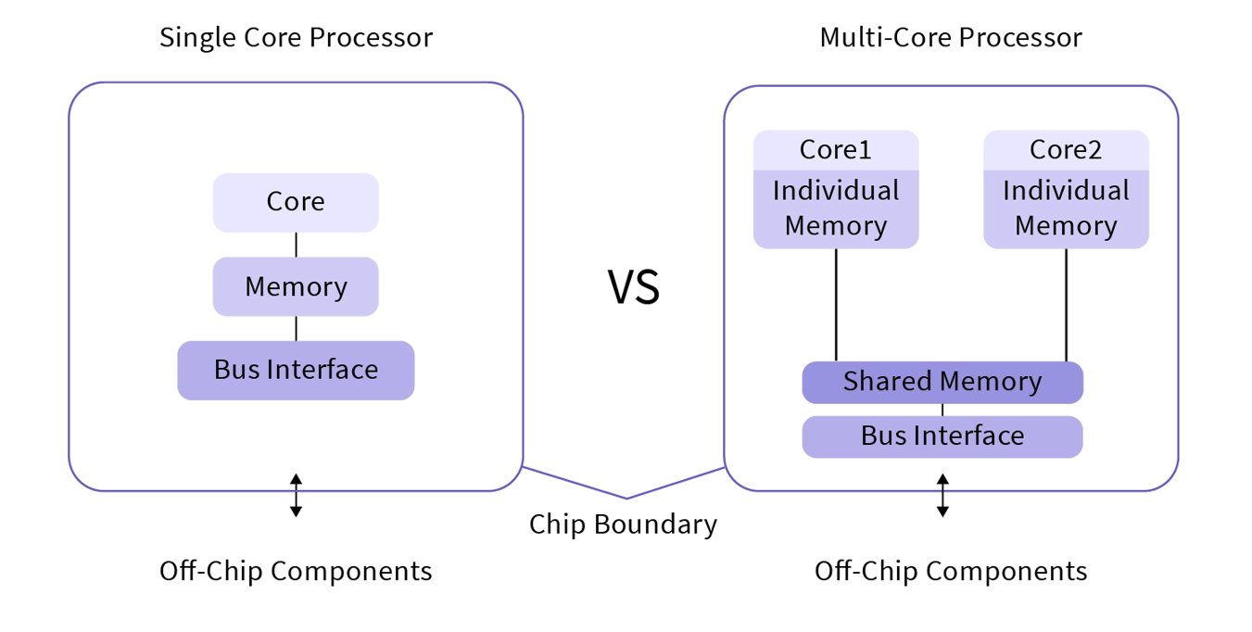

Slide 56
Architecture of multicore processors
Every multicore processor consists of the following components:
Cores
are the central components. Cores contain all of the registers and circuitry (sometimes hundreds of millions of individual transistors) needed to perform the tasks of ingesting data and instruction, processing that content and outputting logical decisions or results.
Processor support circuitry
includes an assortment of input/output control and management circuitry, such as clocks, cache consistency, power and thermal control and external bus access.
Caches
A cache retains often-used instructions or data, making that content readily available to the core without the need to access system memory. A processor checks the cache first. If the required content is present, the core takes that content from the cache, enhancing performance benefits. If the content is absent, the core will access system memory for the required content. A Level 1, or L1, cache is the smallest and fastest cache unique to every core. A Level 2, or L2, cache is a larger storage space shared among the cores. Some multicore processor architectures may dedicate both L1 and L2 caches.

Slide 57
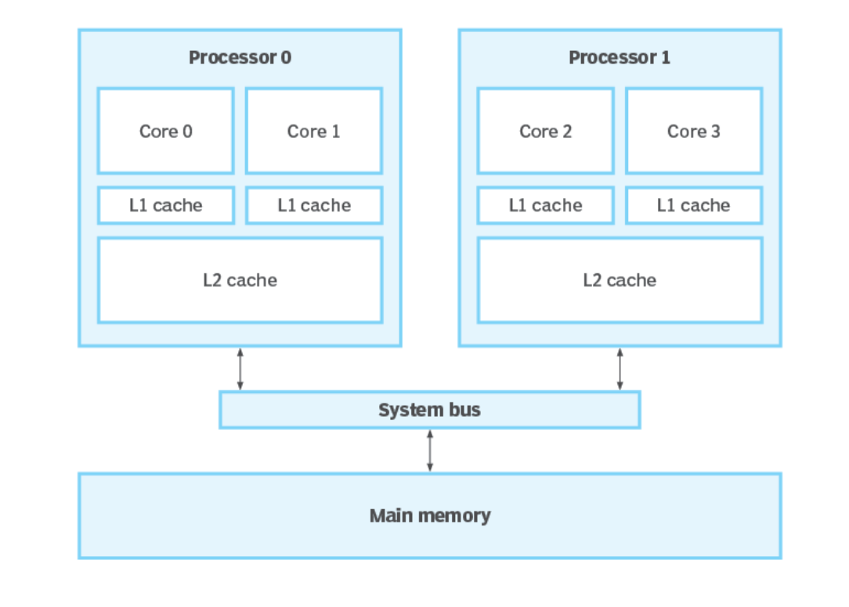

Slide 58
To accelerate performance of multicore systems, it supports the following:
High Clock speed
Hyper-threading
With hyper-threading, processor cores are designed to handle two separate instruction threads at the same time. When properly enabled and supported by both the computer's firmware and operating system (OS), hyper-threading techniques enable one physical core to function as two logical cores.
Increased number of chips

Slide 59
Homogenous vs. Heterogeneous Multicore Processors
Homogeneous cores are identical, share the same architecture and microarchitecture. They can perform exactly the same tasks and have exactly the same capabilities available. The cores are functionally identical.
Heterogeneous cores are not identical. They can differ in capabilities, speed, may lack certain features or otherwise perform a task differently.

Slide 60
Multicore advantages
Better Performance:
Better application performance: Each processor core is effectively a separate processor that OSes and applications can use.
Better hardware performance: By placing two or more processor cores on the same device, it can use shared components -- such as common internal buses and processor caches -- more efficiently.
Reliability: In multi-core CPUs, the software is always assigned to different cores. When one piece of software fails, the others remain unaffected.
Low Power Consumption: Only the part of the CPU that generates heat will be used. The power consumption is eventually minimized, resulting in less battery utilization.
Higher Cache Coherency: refers to the consistency and synchronization of data stored in different caches within a multiprocessor or multicore system. In such systems, each processor or core typically has its own cache memory to improve performance.

Slide 61
Obsolescence Avoidance: Architects can avoid technology obsolescence and increase maintainability by using multicore CPUs.
Isolation: Software on one core is less likely to impact software on the other if both cores are executing on the same single-core.
Software Interactions: Even if the software is running on multiple cores, it will communicate with one another.
Multitasking: We can simultaneously run multiple applications

Slide 62
Multicore disadvantages
Software dependent. Software applications are enabled to use them.
Performance boosts are limited: The processor cores share a package; and the more sharing must take place across common processor interfaces and resources. This results in diminishing returns to performance as cores are added.
Power, heat and clock restrictions. A modern processor core may contain over 500 million transistors. Each transistor generates heat when it switches, and this heat increases as the clock speed increases. When more cores are running, this heat can multiply and quickly exceed the cooling capability of the processor package. Thus, some multicore processors may actually reduce clock speeds.
Jitter: More interference develops as the number of cores in a multi-core CPU increase, resulting in excessive jitters.

Slide 63
Examples of multicore processors
Intel Core i9 12900 family provides 8 cores and 24 threads
Intel Core i7 12700 family provides 8 cores and 20 threads
Top Intel Core i5 12600K processors offer 6 cores and 16 threads
Applications of Multicore Processors
Networking
Embedded systems
Digital signal processing
Graphics), etc

Slide 64
MultiProcessor System :
Multiprocessor systems have multiple processors working in parallel that share the computer clock, memory, bus, peripheral devices etc
It allows parallel execution of different processors
These systems are reliable since failure of any single processor does not affect other processors.
Parallel processing (more than one process executing at same time) is achieved through MultiProcessing
A quad-processor system can execute four processes at a time while an octa-processor can execute eight processes at a time and so on
Multiprocessors system are classified as multiple instruction stream, multiple data stream systems(MIMD)

Slide 65
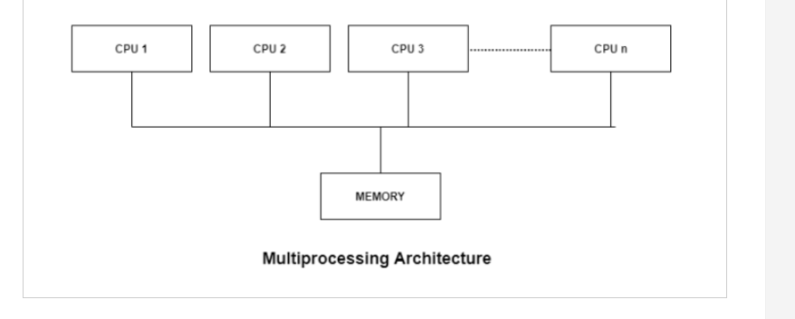
Multiprocessor Architecture

Slide 66
Types of multiprocessing systems
Symmetrical multiprocessing system (Shared every-thing system)
In a Symmetrical multiprocessing system, each processor executes the same copy of the operating system, takes its own decisions, and cooperates with other processes to smooth the entire functioning of the system.
The CPU scheduling policies are very simple. Any new job submitted by a user can be assigned to any processor that is least burdened.
The symmetric multiprocessing operating system is also known as a "shared every-thing" system, because the processors share memory and the Input output bus or data path.
In this system, processors do not usually exceed more than 16.
In these types of systems, each processor contains a similar copy of the operating system and they all communicate with each other.
All the processors are in a peer to peer relationship i.e. no master - slave relationship exists between them.
Example: Encore version of Unix for the Multimax Computer.

Slide 67
Asymmetric multiprocessing system
In asymmetric systems, each processor is given a predefined task.
Asymmetric multiprocessor system contains a master slave relationship.
The designated master processor controls the activities of other processors.
The master processor gives instruction to all the other processors.
The working is as follows: Consider, we have a math co-processor that can handle mathematical jobs better than the main CPU. Similarly, we have an MMX processor that is built to handle multimedia-related jobs. Similarly, we have a graphics processor to handle the graphics-related job better than the main processor. When a user submits a new job, the OS has to decide which processor can perform it better, and then that processor is assigned that newly arrived job. This processor acts as the master and controls the system. All other processors look for masters for instructions or have predefined tasks. It is the responsibility of the master to allocate work to other processors.
Example: SONY CELL processor of PS3 game system

Slide 68
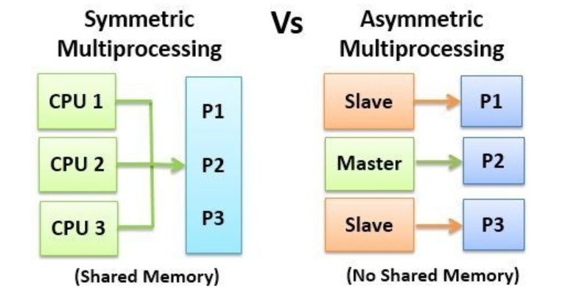

Slide 69
Benefits of using a Multiprocessor
Improved performance: Multiprocessor systems can execute tasks faster than single-processor systems, as the workload can be distributed across multiple processors.
Better scalability: Multiprocessor systems can be scaled more easily than single-processor systems, as additional processors can be added to the system to handle increased workloads.
Increased reliability: If one processor fails; the task can be given to another processor for completion.
Increased throughout: As several processors increase, more work can be done in less time
The economy of Scale: As multiprocessors systems share peripherals, secondary storage devices, and power supplies, they are relatively cheaper than single-processor systems.

Slide 70
Disadvantages :
Complicated Operating System Required: Operating system of multiprocessing is more complex and sophisticated as it takes care of multiple CPUs at the same time.
Large Main Memory Required: All the processors in the multiprocessor system share the memory. So a much larger pool of memory is required as compared to single processor systems.

Slide 71
End of Module 1
(THANK YOU)

